Slide 1

Humanalytics Empowering HR with Sentiment Analysis on Layoffs
University of Missouri–Kansas City
Team Members:
Muhammad Tayyab
Ramya Thambabattula
Dallas Diaz
Muhammad Arslan

Slide 2
Problem Statement
Amidst the prevalent layoffs and evolving workforce dynamics, how can we effectively navigate these complexities to cultivate resilience and promote sustainable employment practices that benefit both individuals and organizations?

Slide 3
https://github.com/arslan719/Capstone_Project_5588/tree/main/Assignment5.2
Group_Github
Team Git:
Ramya:https://github.com/RAMYA19956/Ds_Capstone_Project_5588/tree/main/Assignment%205-2%3A%20Data%20Science%20Capstone%20-%20Final%20Project%20Submission
Arslan: https://github.com/arslan719/Capstone_Project_5588/tree/main/Assignment5.2
Tayyab: https://github.com/mtayyab25/Capstone_CS-5588-/tree/main/Assignmen
Dallas: https://github.com/dallasdiaz93/datasciencecapstone/tree/main/Assignment%20

Slide 4

Member Contribution
Dallas -25% Arslan -25% Tayyab- 25% Ramya -25%

Slide 5
INTRODUCTION
Integrating sentiment analysis into HR dashboard to understand employee reactions during layoffs. By analyzing feedback and social media posts, we gain insights into emotional impacts.
This aligns with our goal of improving user experience, promoting mobility, and ensuring compliance. Our AI-driven analytics provide actionable insights for proactive decision-making.

Slide 6

Objectives
Understanding the Human Impact: Layoffs in today's economy deeply affect individuals and organizations. Analyzing layoff stories unveils the emotional and social challenges faced by those impacted, providing crucial insights into the human side of job loss.
Identifying Trends and Patterns: Systematic analysis of layoff stories reveals recurring trends across industries and regions.
Evaluating Organizational Practices: The examination of layoff stories allows for an assessment of organizational responses, including communication strategies and support mechanisms.
Informing Strategic Decision-making: Insights from layoff story analysis empower policymakers, industry leaders, and HR professionals to develop effective strategies.

Slide 7
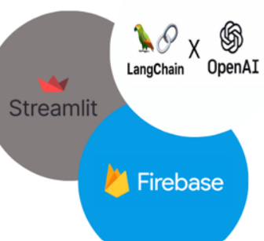
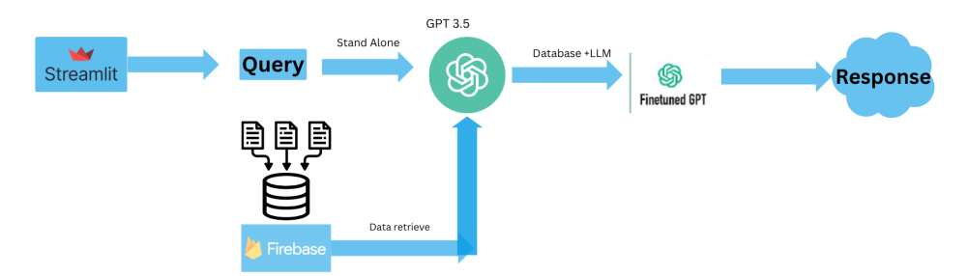
Methodology
Collect datasets: Reddit layoff stories, Twitter layoff stories, Kaggle layoff data, employee feedback, social media posts, textual data related to layoffs.
Utilize advanced AI techniques: Machine learning libraires and models for sentiment analysis.
Analyze textual data to extract sentiments and emotional responses regarding layoffs.
Model Integration: GPT-3.5, llm for intelligent data analysis and interpretation.

Slide 8

Dataset
Raw Data of Layoffs: This foundational dataset contains essential information regarding employee layoffs, including employee names, affected departments, layoff dates, and reasons for termination.
Raw Data from Employee Tweets: An unstructured dataset capturing employee feedback, sentiments, and perceptions related to HR activities through textual data from employee tweets.
Processed Data: The raw datasets undergo processing and transformation to prepare them for analysis and model training.
https://github.com/arslan719/Capstone_Project_5588/blob/main/Phase3.2/data_raw/layoffs_data.csv
https://github.com/arslan719/Capstone_Project_5588/blob/main/Phase3.2/data_raw/tweets.csv
https://github.com/arslan719/Capstone_Project_5588/blob/main/Phase3.2/data_raw/reddit_layoff.csv

Slide 9
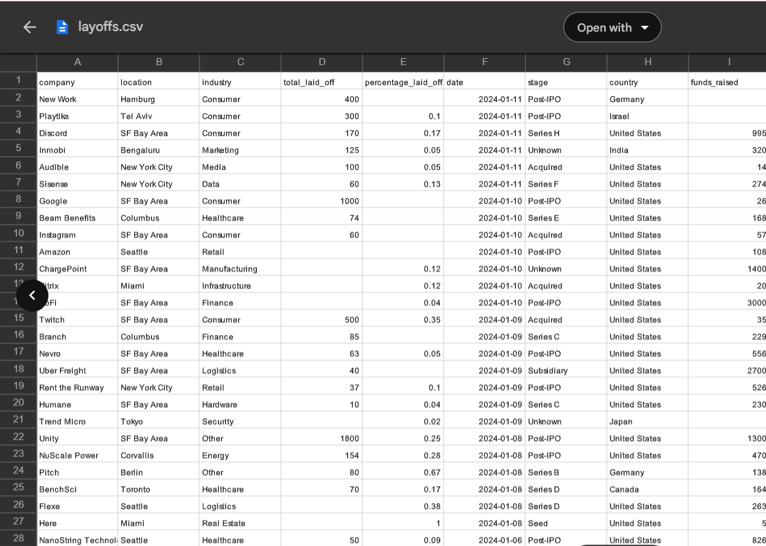
Raw Data of Layoffs
The core dataset contains comprehensive details of employee layoffs, including names, affected departments, termination dates, and reasons. By integrating this data with employee feedback and sentiment analysis, the dashboard offers HR professionals insights into emotional impacts, aiding informed decision-making during layoffs.

Slide 10
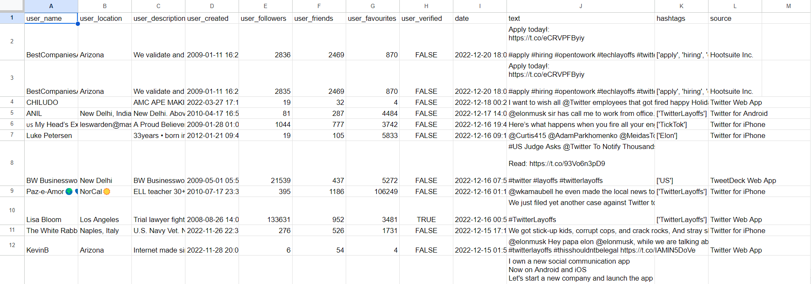
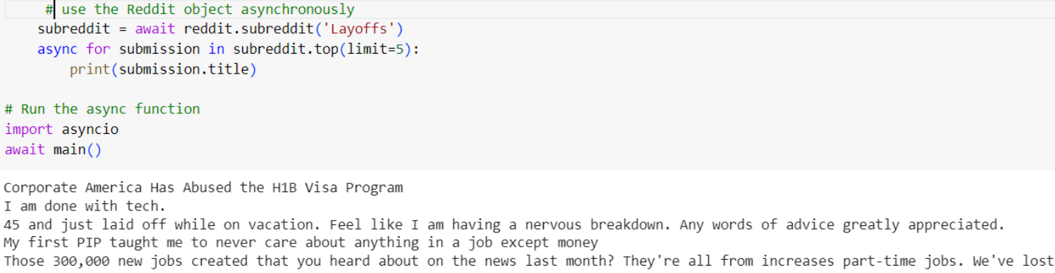
Raw Data from Employee Tweets
The raw data from employee tweets is an unstructured dataset containing textual data from employee tweets, capturing their feedback, sentiments, and perceptions related to various HR activities.

Slide 11
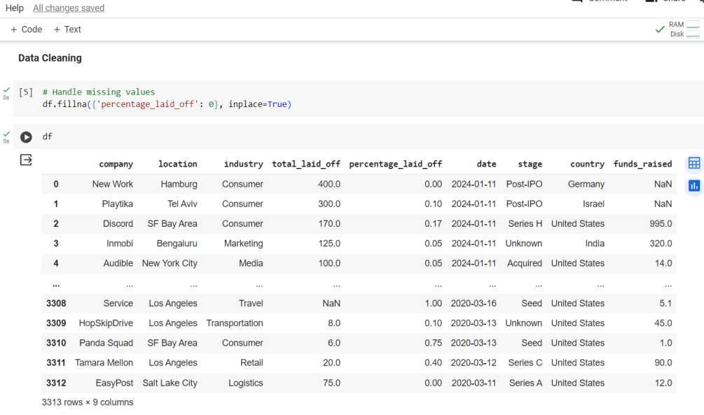
Data Cleaning

Slide 12
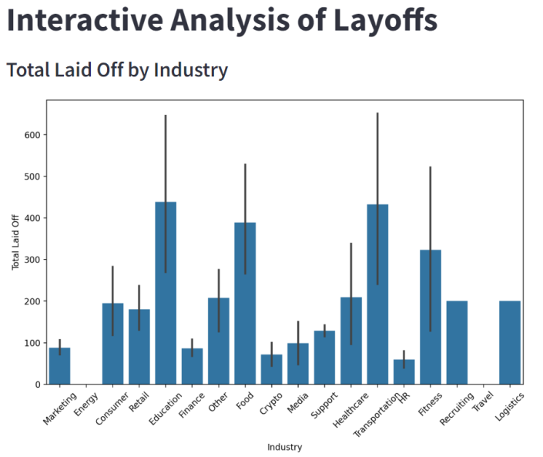
Visual representation of Layoffs Data
Figure 2

Slide 13
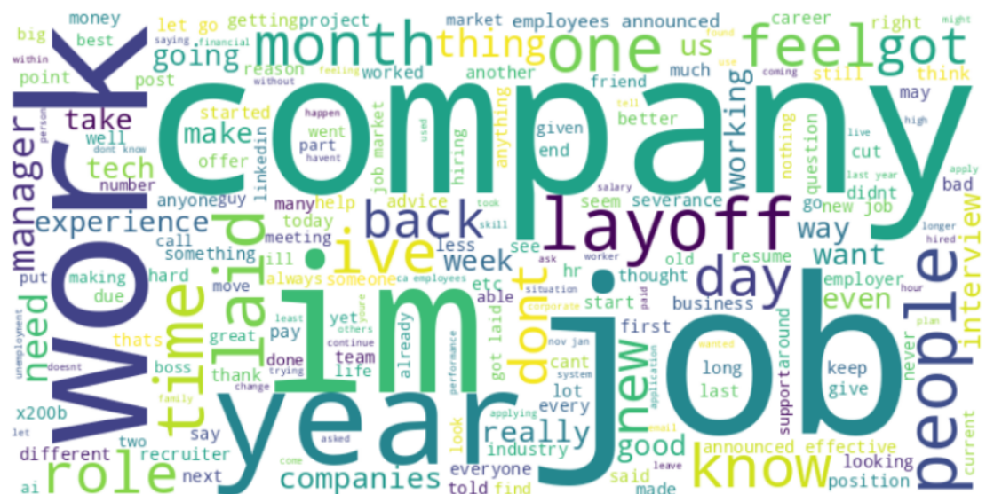
Sentiment Analysis of text Data
Sentiment analysis on layoff text data
reveals a prevailing negative sentiment.
•Employees express feelings of
disappointment, frustration, and
sadness.
•Negativity is heightened in texts
discussing ramifications on careers and
financial stability.
•Sentiments of uncertainty and anxiety
about the future are evident.
•Employees express apprehensions
about securing new job opportunities
and navigating post-layoff challenges

Slide 14
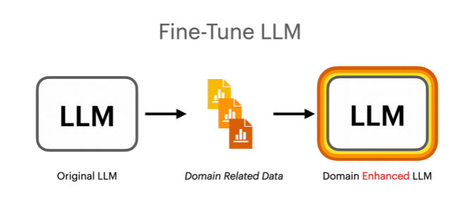
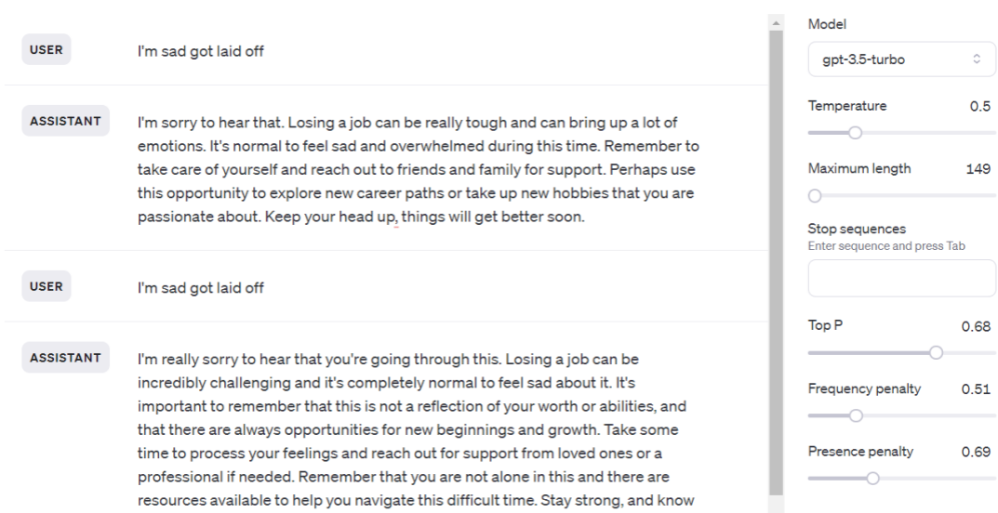
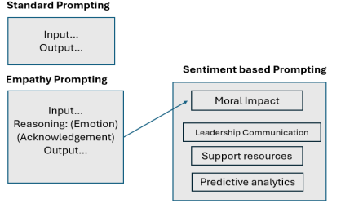
Fine tunning LLM

Slide 15
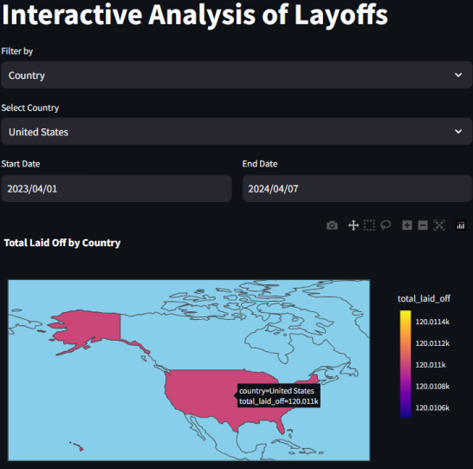
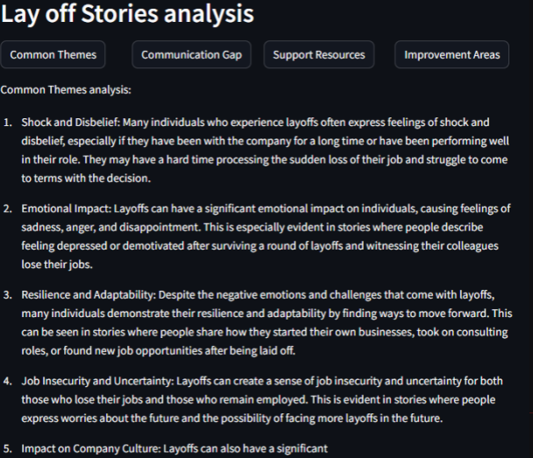
Streamlit Dashboard of Humanlytics

Slide 16
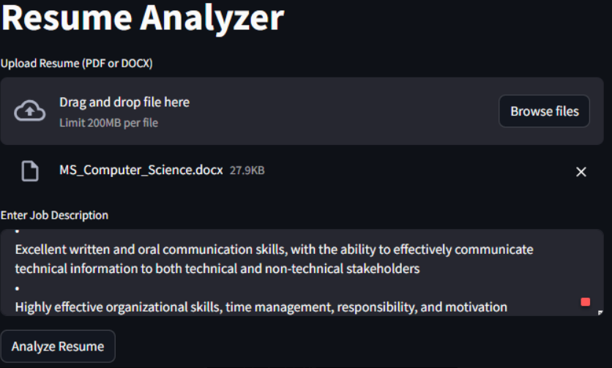
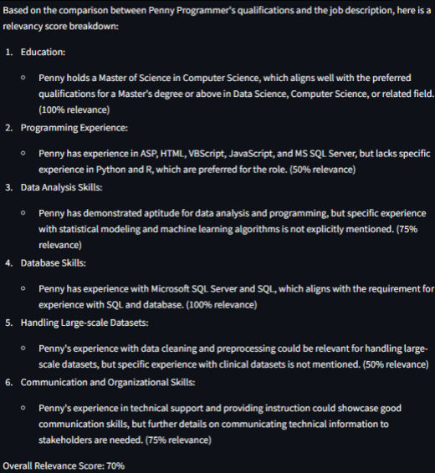
Resume Analysis

Slide 17
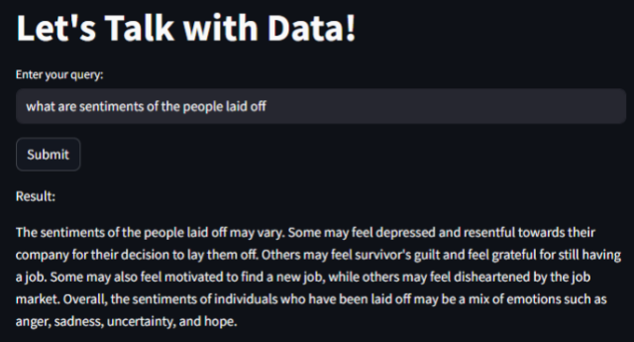
Q&A with data

Slide 18
Future Work
Collecting more data and refining the current capabilities of application.
Feature engineering and adding new feature empowering the llm to cater the HR.
Conduct continuous research for further analysis.

Slide 19
Conclusion
Introduces innovative approach to HR practices with
Recruitment Prediction Dashboard.
Combines frontend, backend, and AI components for
real-time insights.
Streamlines recruitment processes and enhances user
experience.
Ensures data security and compliance.
Integrates features like resume analysis and sentiment
analysis for enhanced functionality.

Slide 20
ReferenceS
[1] https://streamlit.io/
[2] https://colab.research.google.com/
[3] https://platform.openai.com/docs/models
[4] https://www.reddit.com/r/Layoffs/
[5] https://www.kaggle.com/datasets/theakhilb/layoffs-data-2022

Slide 21

THANK YOU

